Slide 1

RISK AND RESILIENCE BOOTCAMP
2

Slide 2


Slide 3
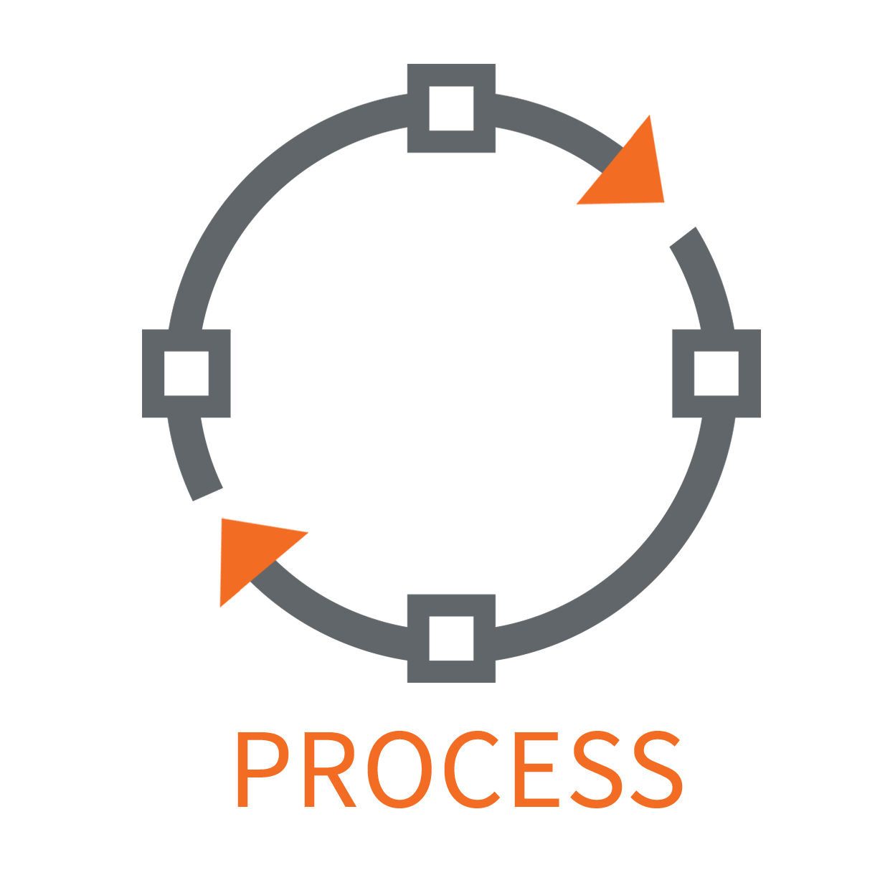
Process maturity
In this module, we will
Examine the concept of process maturity in IT
How it helps or hinders risk and resiliency management
How it applies to our own risk and resiliency processes

Slide 4
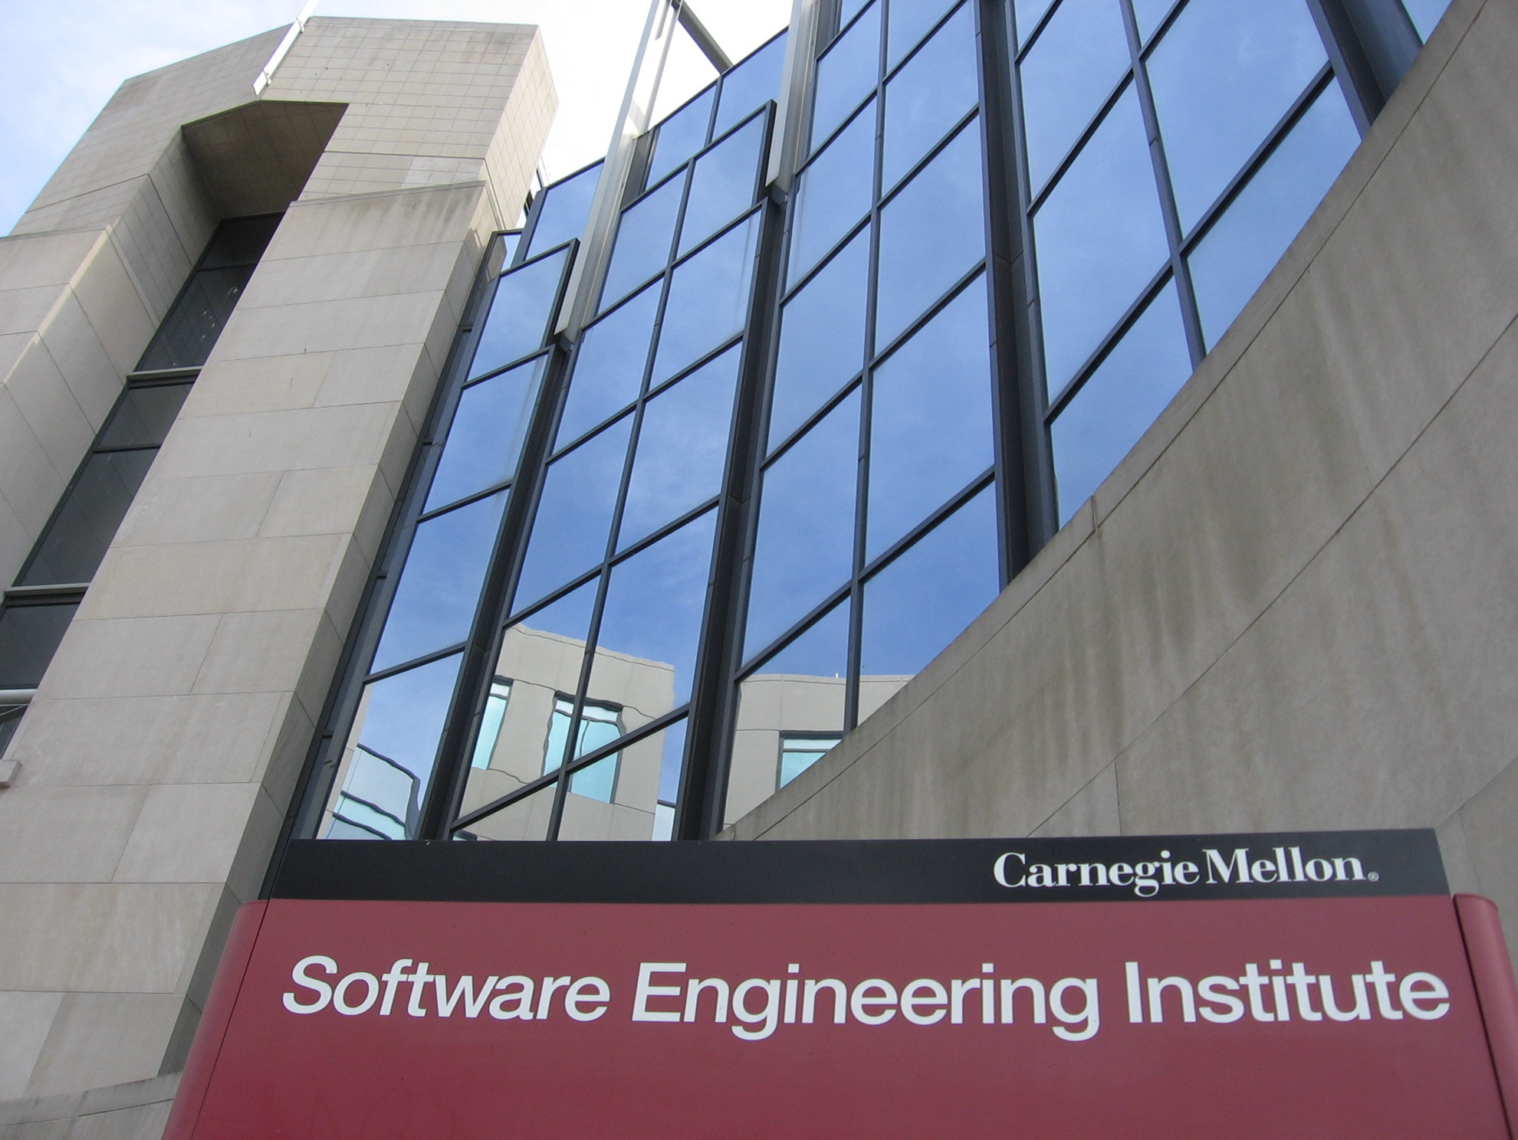
Software Engineering Institute
Commissioned by US Government (DoD) to find out how organizations built high quality software
Found it depended on three factors:
The organization had a defined software production process
The organization followed the process when they built software
They were always improving the process in terms of efficiency and effectiveness
The measure of how well the organization follows these three factors is called process maturity

Slide 5
Immature Organizations
The process is often improvised by the developers and management during the course of the project
Defined processes are often not followed or enforced
Project activities are reactionary and often focus on solving immediate crises
Schedules and budgets are based on unrealistic estimates and routinely exceeded
Bringing a project in line with deadlines or costs causes functionally and product quality to suffer
Product quality is difficult to predict and there are no objective standards to assess product quality

Slide 6
Immature Organizations
There are no standard ways for solving problems, everything is done on a “fire­fighting” basis where the same problems keep recurring with the same negative impacts
The defined process is not realistic and the organization is characterized by the attitude “Following the rules won't get the job done”
The defined process is often created in part by those who are not part of the development staff and tends to be more about reporting and management activities than work tasks

Slide 7
Mature Organizations
The software process is standardized across the organization and communicated to all existing staff and new employees
All work activities are carried out according to the planned process
The processes are usable and realistic because they describe how work actually gets done
Defined processes are updated as necessary
Improvements to the process are planned and evaluated through pilot tests or cost benefit analyses

Slide 8
Mature Organizations
Responsibilities are defined clearly in the organization and in each project
Management continuously monitors the quality of the products and the processes using objective and quantifiable criteria
There are defined processes for analyzing and solving problems with the product with diagnostic and remediation processes
Budgets and schedules are realistic because they are based on historical performance data
The infrastructure of the organization supports the process
A disciplined process is consistently followed because all of the participants understand the value of doing so and enforce following the process at a peer level

Slide 9
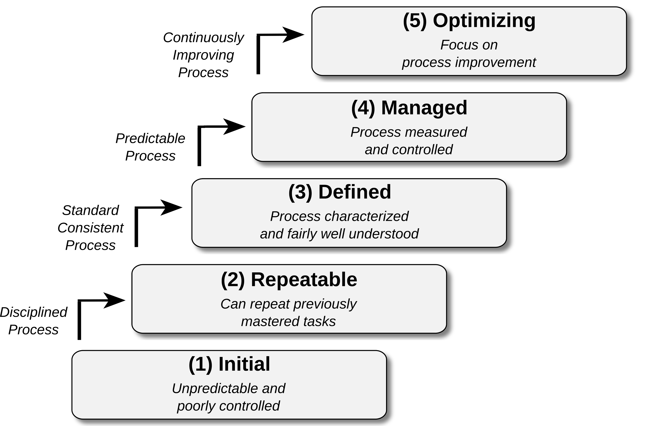
The levels

Slide 10
The Levels
Initial
Describes a start-up company with no defined processes
Processes are counter productive and often inhibit innovation
Large process mature companies will often spin off incubator startups
These incubators provide a free-wheeling entrepreneurial environment
Repeatable
Production process mastered: all projects are on spec, on time and to budget
Processes are well documented and standardized within specific projects or areas
For example, the QA department has a set of efficient and effective testing processes
The operations group has a set of standardized monitoring and deployment procedures

Slide 11
The Levels
Encultured
The organization has standardized processes that are used across the organization
They have customizable templates to tailor the process to specific requirements
For example:
Data migration project
Customer UI enhancement project
Regulatory compliance implementation project
However, it is more than just having a standardized set of processes
The processes are followed consistently and correctly
This happens when following the process is part of the organizational culture
It’s 'the way we do it here’ and is enforced by everyone in the organization
People who don’t follow the process are sanctioned by their peers, not management

Slide 12
The Levels
Proactive
Having a standard process from level 3 allows the collection of standard data
Measures the effectiveness and efficiency of the process across projects
Allows for the development of standards and best practices
These are empirical, based on historical data
This results in a review based culture
Everything is reviewed to ensure it is in alignment with best practices and quality metrics
Proactively identifying problems and issues before they can occur
Includes application code, deployment processes, operations procedures
Best practices are constantly updated to incorporate new data

Slide 13
The Levels
Integrated
Processes are not only standardized and reviewed but are fully embedded into the organization’s ecosystem
They are interconnected across functional areas and self-correcting
Deviations or inefficiencies are automatically detected and resolved without waiting for external intervention
Some characteristics of this level
Continuous Feedback Loops: Monitoring, analytics, and automation feed data back into processes in real-time, enabling proactive adjustments
Predictive Risk Management: Instead of reacting to issues, predictive analytics and trend analysis identify potential risks before they occur
Cross-Functional Integration: Risk, operations, governance, and development streams (like in ALM) are tightly linked so changes in one area immediately reflect in others
Culture of Resilience: Resilience isn’t just a goal: it’s baked into every decision. Staff at all levels act with risk-awareness as second nature

Slide 14
Time to maturity
A long and difficult journey
Getting to level two represents a major accomplishment for many organizations
Organizations don’t just decide to be at a specific level
The levels are benchmarks of growth and progress
Not a set of rules that are followed or checklists
Based on measurable qualities of the organization’s culture and working processes
Each level builds on mastering the preceding levels
Getting to level two is often the hardest
Because of the number of foundational processes that need to be mastered
For example: data management, QA and testing, code development, etc.
It’s not unusual for an organization to take ten years to get to level five, but seven years of the ten to get to level two

Slide 15
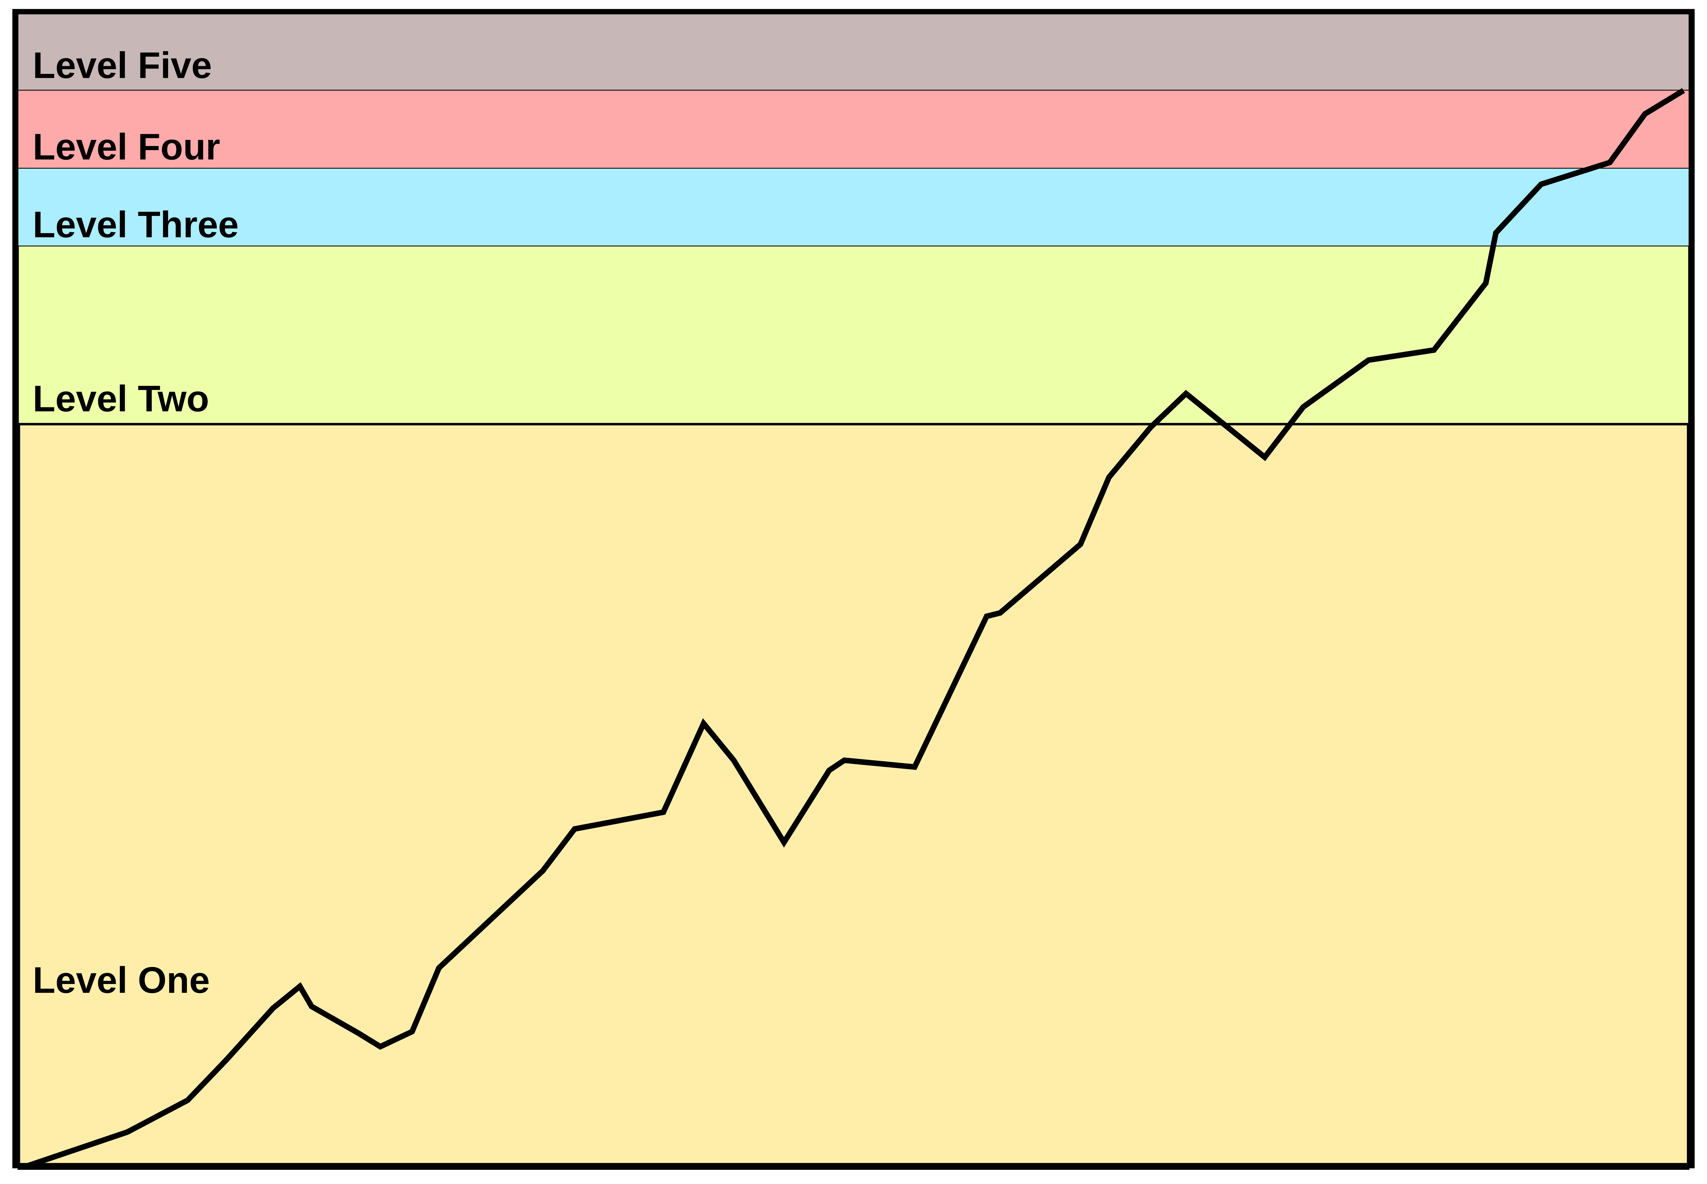
Time to maturity

Slide 16
Immaturity levels
In response to the maturity level model
Tom Schorsch proposed a set of immaturity levels
These levels were intended to satirize the fact that many organizations are not interested in becoming process mature or getting better at what they do
The immaturity levels
Level 0: Negligent: Indifference
Failure to allow successful development process to succeed
All problems are perceived to be technical problems (“It’s because we use Linux”)
Managerial and quality assurance activities are deemed to be overhead and superfluous to the software development process
Reliance on silver bullets and miracle solutions (“Let’s just make everything a microservice”)

Slide 17
Immaturity levels
Level -1: Obstructive: Counter Productive
Counterproductive processes are imposed
Processes are rigidly defined and adherence to the format is stressed
Ritualistic ceremonies abound replacing productive work planning
Collective management precludes assigning responsibility
Status quo über alles
Level -2: Contemptuous: Arrogance
Disregard for good software engineering institutionalized
Complete schism between software development activities and software process improvement activities
Complete lack of a training program
“Industry-wide processes and standards won’t work for us because we are unique and unlike anyone else”

Slide 18
Immaturity levels
Level -3: Undermining: Sabotage
Total neglect of own charter
Conscious discrediting of peer organizations’ software process improvement efforts
Rewarding failure and poor performance

Slide 19
Risk and Resilience Analysis
Level 1: Initial (ad hoc / startup mode)
Strengths
High flexibility, rapid innovation, ability to pivot quickly
Low bureaucracy
Weaknesses
No consistent processes: unpredictable outcomes
High dependency on individuals, not systems
No institutional resilience; survival depends on firefighting

Slide 20
Risk and Resilience Analysis
Level 1: Initial (ad hoc / startup mode)
Risk and resilience implications
Preventive controls: Absent or inconsistent
Detective controls: Minimal, often manual
Corrective controls: Reactive only; recovery depends on heroic effort
Very fragile to disruptions; downtime or incidents can be catastrophic
Examples
A startup releasing features without QA or security testing
Small businesses relying on one sysadmin to handle outages
Early dot-com companies where “move fast and break things” was the norm

Slide 21
Risk and Resilience Analysis
Level 2: Repeatable (basic project discipline)
Strengths
Processes exist and can be repeated with predictable outcomes
Projects delivered on time, within budget, meeting basic specs
Beginning of operational stability
Weaknesses
Still project-centric, not an organization-wide culture discipline
Risk management is procedural, not proactive
Resilience depends on discipline of teams rather than systemic enforcement

Slide 22
Risk and Resilience Analysis
Level 2: Repeatable (basic project discipline)
Risk and resilience implications
Preventive controls: Introduced (checklists, basic SOPs)
Detective controls: Project reviews and monitoring start to appear
Corrective controls: Still heavily reliant on manual intervention
Moderate resilience: disruptions can be recovered from, but only with effort
Examples
An IT team that has a standard patching process but no enterprise-wide monitoring
A bank’s IT division delivering projects reliably, but each project operates in silos
Organizations following ITIL checklists mechanically but without cultural adoption

Slide 23
Risk and Resilience Analysis
Level 3: Encultured (institutionalized process)
Strengths
Processes embedded into culture: “the way we do things here”
Broad organizational buy-in; staff enforce consistency
Risk awareness starts becoming cultural
Weaknesses
Culture can become rigid; resistant to innovation
Risk handling still relies on compliance rather than continuous improvement
May create “checkbox resiliency” (following rules without adaptive thinking)

Slide 24
Risk and Resilience Analysis
Level 3: Encultured (institutionalized process)
Risk and resilience implications
Preventive controls: Widely adopted; culture enforces SOPs
Detective controls: Routine monitoring and audits exist
Corrective controls: Documented recovery processes followed consistently
Stronger resilience: outages handled predictably, though recovery may still be slow
Examples
Hospitals enforcing hygiene checklists at every stage of care
IT organizations where patching, access control, and backup processes are religiously followed

Slide 25
Risk and Resilience Analysis
Level 4: Proactive (continuous review / alignment)
Strengths
Processes are actively reviewed and aligned with best practices
Metrics and quality benchmarks drive improvement
Risk management shifts from compliance to anticipation
Weaknesses
Heavy reliance on review cycles; still retrospective (fix after reviewing)
Can be slow if review processes are bureaucratic
If reviews lag, risks slip through

Slide 26
Risk and Resilience Analysis
Level 4: Proactive (continuous review / alignment)
Risk and resilience implications
Preventive controls: Regularly refined against industry standards
Detective controls: Formalized reviews, audits, benchmarking
Corrective controls: Feedback loops exist, but still human-driven
High resilience: the organization is unlikely to repeat mistakes, but not yet self-healing
Examples
Tech companies adopting DevSecOps reviews and automated quality metrics
Financial institutions with constant regulatory alignment reviews
Aviation industry processes with rigorous after-action reviews

Slide 27
Risk and Resilience Analysis
Level 5: Integrated (self-correcting enterprise)
Strengths
Processes interconnected, adaptive, and self-correcting
Continuous monitoring and automation reduce human error
Risk awareness is systemic; resilience is built-in
Weaknesses
High cost and complexity to implement
Requires strong governance and advanced analytics
Risk of over-reliance on automation without human oversight

Slide 28
Risk and Resilience Analysis
Level 5: Integrated (self-correcting enterprise)
Risk and resilience implications
Preventive controls: Automated, predictive (e.g., AI detecting risks early)
Detective controls: Advanced analytics, real-time anomaly detection
Corrective controls: Automated failover, rollback, and self-healing systems
Resilience is dynamic: systems adapt in real-time, minimizing impact of disruptions
Examples
Cloud-native companies with automated self-healing infrastructure
High-frequency trading platforms with real-time risk engines
Large-scale e-commerce (Amazon, Netflix) using chaos engineering to continuously test resilience

Slide 29
Risk & Resilience capabilities
Level 1: Initial (ad hoc / startup)
What you can do
React to incidents as they occur
Rely on individual heroics to restore systems
Learn from major failures (if knowledge is captured)
Limits
Cannot systematically prevent risks
Cannot guarantee recovery or resilience (no processes in place)
Limited visibility into risks: only the obvious ones are seen
Highly fragile; any disruption can derail operations

Slide 30
Risk & Resilience capabilities
Level 2: Repeatable (project discipline)
What you can do
Deliver projects consistently on time and within budget
Apply basic preventive measures (e.g., patching SOPs, change control)
Recover from common incidents with repeatable playbooks
Limits
Cannot ensure organization-wide risk management (processes are siloed)
Cannot adapt rapidly to new risks: improvements lag
Resilience depends on discipline of teams, not systemic enforcement
Still reactive when facing novel or complex risks

Slide 31
Risk & Resilience capabilities
Level 3: Encultured (institutionalized process)
What you can do
Enforce processes through culture: everyone follows the process
Achieve consistent resiliency in routine operations (e.g., backups, patching)
Create organizational memory of risk responses
Limits
Cannot easily innovate: culture resists change
Cannot adapt processes quickly to new risk scenarios
Risks outside the “cultural model” may go unseen (blind spots)
Resilience is strong but not agile; recovery can be slow

Slide 32
Risk & Resilience capabilities
Level 4: Proactive (continuous review / alignment)
What you can do
Continuously refine controls based on reviews, audits, and metrics
Anticipate risks using trends and lessons learned
Prevent recurrence of known failures
Maintain high compliance and alignment with best practices
Limits
Cannot yet self-correct in real time; responses still depend on human review
Cannot fully predict or prevent novel/black swan risks
Resilience is high but still retrospective: based on after-the-fact improvement
Review cycles may delay action if governance is slow

Slide 33
Risk & Resilience capabilities
Level 5: Integrated (self-correcting enterprise)
What you can do
Automate preventive, detective, and corrective controls
Predict and mitigate risks before they occur
Self-heal during disruptions (e.g., auto-failover, rollback)
Achieve dynamic resilience across the enterprise
Limits
Cannot eliminate all risks: black swan events still possible
Automation may miss context or create false confidence
High implementation costs and complexity limit feasibility for smaller organizations
Over-reliance on AI/automation can create hidden risks if not overseen

Slide 34
Capability Models
Maturity modeling is a universal approach
Applied to testing, data, continuity, cybersecurity, governance, people, operations and development
The core pattern is always
From ad hoc → repeatable → institutionalized → optimized → adaptive/self-correcting
These flesh out the maturity framework with specific milestones and practices that are relevant for that domain
Some of these, like the testing and data maturity models depend on the overall process maturity level of the organization
As a rule of thumb, a specialized maturity model is often, but not always, limited to the overall maturity level of the organization

Slide 35
CERT Resilience Management Model
CERT Resilience Management Model (CERT-RMM)
Developed by Carnegie Mellon’s CERT (Computer Emergency Response Team)
Focused on operational resilience, security risk management, and continuity of critical services
Integrates principles of security, business continuity, and IT operations into a single maturity model
Widely used in critical infrastructure sectors (finance, energy, government)
Unlike generic models, CERT-RMM is explicitly designed for operational resilience
Directly ties risk management, security, and continuity together
Level 1–2 = survival by firefighting (fragile resilience)
Level 3 = consistency (resilience by design)
Level 4 = predictability (resilience by measurement)
Level 5 = adaptability (resilience as a living capability)

Slide 36
CERT Resilience Management Model
Level 0: Incomplete
No formal resilience processes in place, just ad hoc responses to incidents
Strengths
Flexibility, quick improvisation
Weaknesses
No predictability, high dependence on individuals, reactive only
Risk and resilience implications
Preventive: None
Detective: Incidents discovered accidentally or by external parties
Corrective: Recovery is improvised, often incomplete
Organizational resilience is fragile: disruptions often catastrophic
Example
A small startup with no backups, no disaster recovery plan, and ad hoc security

Slide 37
CERT Resilience Management Model
Level 1: Performed
Some resilience-related practices exist but are inconsistent and undocumented
Strengths
At least basic awareness of the need for resilience
Weaknesses
Reliance on individuals; outcomes unpredictable
Risk and resilience implications
Preventive: Basic measures (passwords, occasional backups)
Detective: Manual monitoring, informal reporting
Corrective: Incident response handled ad hoc
Resilience still low and unpredictable
Example
IT team that occasionally patches systems and keeps informal backup copies

Slide 38
CERT Resilience Management Model
Level 2: Managed
Resilience practices are planned and tracked at the project or team level
Processes repeatable, but not standardized enterprise-wide
Strengths
Teams can deliver resilience outcomes consistently
Weaknesses
Silos; resilience varies across the organization
Risk and resilience implications
Preventive: Basic SOPs for security, backup, patching
Detective: Logs reviewed manually or semi-regularly
Corrective: Recovery documented but not standardized across units
Resilience moderate but fragmented: depends on team maturity
Example
One business unit has a tested recovery plan; others rely on ad hoc fixes

Slide 39
CERT Resilience Management Model
Level 3: Defined
Organization-wide resilience processes are defined, documented, and standardized. Clear policies exist for continuity, risk, and security
Strengths
Consistency across the enterprise; resilience part of culture
Weaknesses
May become compliance-focused; adaptation to new risks still slow
Risk and resilience implications
Preventive: Enterprise-wide policies (security standards, resilience training)
Detective: Consistent monitoring and incident tracking
Corrective: Recovery procedures formally documented and tested
Strong resilience, but not yet adaptive
Example
A bank adopting standardized incident response and continuity planning across all departments

Slide 40
CERT Resilience Management Model
Level 4: Managed and measured
Resilience processes are quantitatively managed and measured with performance metrics (MTTR, incident trends, compliance KPIs)
Strengths
Decisions driven by data and continuous measurement; risk appetite and tolerance explicitly managed
Weaknesses
Measurement frameworks can be rigid or overly complex
Risk and resilience implications
Preventive: Continuous improvement of controls based on risk metrics
Detective: Advanced monitoring, dashboards, regular testing of resilience
Corrective: Lessons learned fed back into resilience planning
Resilience is strong, predictable, and improving over time
Example
A power grid operator measuring resilience metrics like recovery time and incident containment rate, adjusting controls proactively

Slide 41
CERT Resilience Management Model
Level 5: Optimizing
Resilience is institutionalized, adaptive, and continuously optimized
Organization learns and evolves in real time
Strengths
Predictive resilience through analytics and automation; resilience is self-correcting
Weaknesses:
High cost and complexity; potential over-reliance on automation
Risk and resilience implications:
Preventive: Automated threat intelligence integration, predictive risk models
Detective: AI-driven anomaly detection, continuous monitoring
Corrective: Self-healing systems, automated failover, continuous learning
Dynamic resilience: Organization adapts to risks as they emerge
Example
Large e-commerce platform (e.g., Amazon) continuously running chaos engineering to validate resilience; financial markets with predictive risk engines

Slide 42
Business Continuity Maturity Model
Developed by the Business Continuity Institute (BCI) and industry practitioners
Provides a structured way to assess an organization’s business continuity (BC) and recovery planning maturity
Levels run from ad hoc self-governed efforts to fully optimized, enterprise-wide resilience capability
Level 1–2 = survival through local heroes
Level 3 = consistency across the enterprise
Level 4 = data-driven improvement
Level 5 = resilience as a competitive advantage

Slide 43
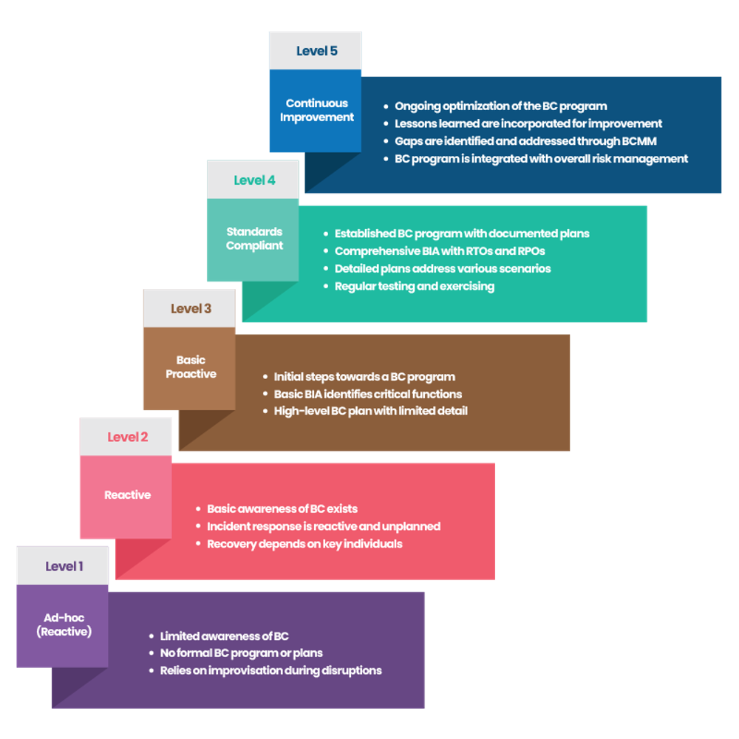
Business Continuity Maturity Model

Slide 44
Business Continuity Maturity Model
Level 1: Self-governing
Continuity efforts are isolated, often initiated by individuals or specific teams
No enterprise recognition
Strengths
Some awareness exists; motivated individuals may keep local processes alive
Weaknesses
No formal governance; fragmented, inconsistent, and unreliable
Risk and resilience implications
Preventive: Minimal; depends on local champions
Detective: No systematic monitoring of continuity risks
Corrective: Recovery is improvised, often incomplete
Resilience: Fragile: survival depends on local initiative
Example
An IT admin who personally runs backups without management support or policy

Slide 45
Business Continuity Maturity Model
Level 2: Repeatable
Continuity processes are repeatable within certain areas but not standardized
BC plans exist for critical functions
Strengths
Predictability within pockets of the organization
Weaknesses
Plans vary in quality; no organizational oversight
Risks outside critical areas remain unmanaged
Risk & Resilience Implications
Preventive: SOPs exist in certain departments
Detective: Limited monitoring, manual checks
Corrective: Local recovery possible, but gaps in coverage
Resilience: Better than ad hoc, but fragmented: a disruption may expose unprotected areas
Example
A business unit maintains a tested continuity plan, but other units have none

Slide 46
Business Continuity Maturity Model
Level 3: Defined
Enterprise-wide BC policies and processes defined
Roles and responsibilities assigned; continuity embedded into organizational culture
Strengths
Standardization across the organization; consistent coverage
Weaknesses
Focus may be compliance-driven; adaptation to new risks still limited
Risk and resilience implications
Preventive: Enterprise-level BC policies enforce preventive controls
Detective: Regular monitoring and reviews of continuity plans
Corrective: Documented and tested recovery procedures
Resilience: Consistent and reliable, but may lag in agility
Example
A global bank standardizes its continuity framework across all regions and tests critical recovery processes annually

Slide 47
Business Continuity Maturity Model
Level 4: Managed
Continuity processes are monitored, measured, and proactively managed with performance metrics (RTO, RPO, recovery success rates)
Strengths
Continuous improvement based on data; proactive adjustments
Weaknesses
Risk of excessive focus on metrics; bureaucratic slowdowns
Risk and resilience implications:
Preventive: Controls regularly updated based on risk metrics
Detective: Advanced monitoring systems track compliance and risks
Corrective: Lessons learned systematically integrated
High resilience: tested, measured, and predictable
Example
A telecom provider measures time-to-recovery after outages and improves continuity planning based on trend analysis

Slide 48
Business Continuity Maturity Model
Level 5: Optimized
Continuity is institutionalized as a dynamic, adaptive capability
Resilience processes are integrated across business, IT, supply chain, and partners
Strengths
Self-optimizing and adaptive; BC is a strategic capability that drives competitive advantage
Weaknesses
High complexity, costly to maintain, requires executive commitment
Risk and resilience implications
Preventive: Predictive continuity planning; proactive risk scenario modeling
Detective: Real-time monitoring, automated continuity drills (e.g., chaos engineering in IT)
Corrective: Automated recovery and adaptive response mechanisms
Resilience: Enterprise-wide, adaptive resilience: disruptions absorbed with minimal impact
Example
Amazon or Netflix continuously stress-test their operations (via chaos engineering) to validate continuity and resilience at scale

Slide 49
Risk and resilience maturity
Risk and resilience work is a process
Identifying risks, writing SOPs, testing recovery plans, or proposing controls, are not one-off tasks
These are repeatable activities that are structured, measured, and improved over time
Like software testing, risk management itself has a maturity curve

Slide 50

Q&A and open discussion
Notes:
Now is the time to engage in an interactive Q&A session where you can ask questions, share insights, and clarify any doubts about the topics we have covered so far.
This open discussion is designed to ensure that every participant has the opportunity to voice their thoughts and learn from the collective experience of the group.
Your questions and comments are valuable as they help us identify areas that may need further explanation and enable us to tailor future sessions to your needs.
We encourage you to speak up and contribute to the dialogue, as this interaction is one of the key components of our interactive learning approach.
As the session progresses, take note of any questions or ideas that you would like to revisit, and feel free to share your perspectives with the class.

